Slide 1


OVER 400 WORKED SOLUTIONS TO:
11+ MATHS ENTRANCE EXAM QUESTIONS
NOTE: This resource is not permitted to be used, copied and/or adapted by schools, tutors, tuition centres or any other form of educational establishment or person. It must neither be passed on for free or sold for a fee by the purchaser or anybody else.
© Mistry Maths www.11practicepapers.co.uk

Slide 2
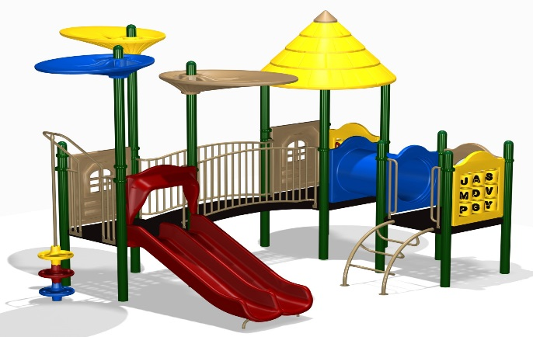
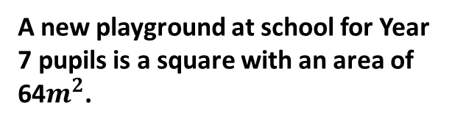
11+ MATHS ENTRANCE EXAM QUESTIONS
48)
A new playground at school for Year 7 pupils is a square with an area of 64$m^{2}$.
(a) Write down the length of one side of the square playground.
49)
Write down the next two numbers in the sequence.
Find the number which multiplies by itself to make 64.
8cm
25
36
SQUARE
8cm
0, 1, 4, 9, 16, ……. , …….
Length = 8cm
This is a sequence of square numbers.
(b) Find the perimeter of the square.
0 x 0 = 0
1 x 1 = 1
2 x 2 = 4
3 x 3 = 9
4 x 4 = 16
5 x 5 = 25
Perimeter is the length all the way around a shape.
6 x 6 = 36
A new fence had to be built around the outside of the playground.
Perimeter = 8 + 8 + 8 + 8
Perimeter = 32cm
50)
From the numbers:
51)
From the list of measurements below choose one to complete each of the sentences.
If 135 x 44 = 5940, write down, without calculating, the value of:
52)
1, 2, 3, 4, 5, 9, 12, 14, 15, 16, 20, 21, 27, 30, 50
(a) 1350 x 44
= 59400
(a) List the prime numbers.
2, 3 and 5
1.4m
85kg
450cm
This is 10 times bigger.
Prime numbers only have two factors. They are 1 and itself.
10ml
50litres
3000g
(a) The saleswoman filled her car with ________ of petrol.
(b) 135 x 4.4
= 594
(b) List all the multiples of 7.
14 and 21
50 litres
Numbers in the 7 times table.
(b) Only people who were taller than ________ were allowed to go on the rollercoaster.
This is 10 times smaller.
(c) List all the factors of 50.
1, 2, 5 & 50
1.4m
= 440
(c) 5940 ÷ 13.5
All the numbers which go into 50 exactly.
(d) List all the square numbers.
1, 4, 9 & 16
3000g
This is 10 times bigger.
(c) Rebecca weighed ________ when she was born.
Look at the numbers in question 49

Slide 3
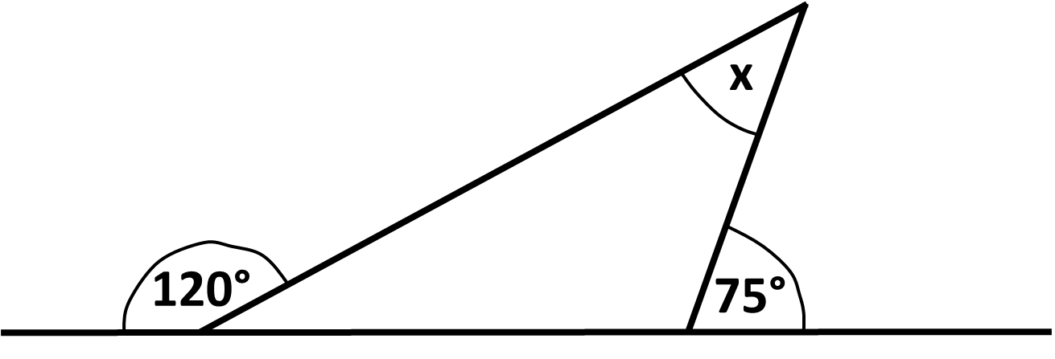
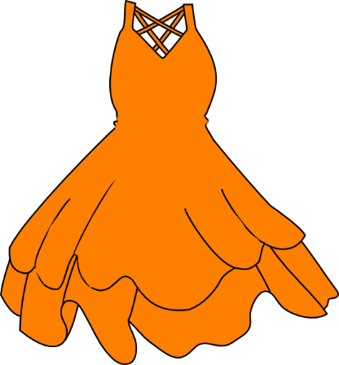

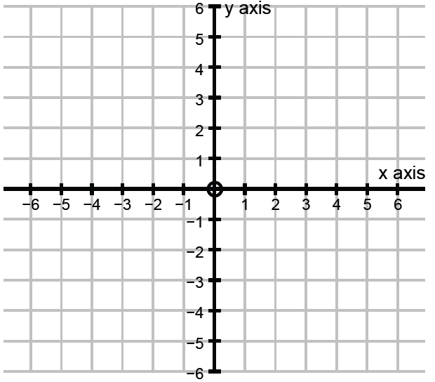
11+ MATHS ENTRANCE EXAM QUESTIONS
234)
Hannah went shopping and bought three dresses for £27.50 each and two large chocolate bars for £1.40 each. How much change did Hannah get from £100?
235)
Work out the value of angle x below:
2 7 5 0
x
£1.40 x 2
=
0
2
1
0
£2.80
0
6
1
5
0
3
8
2
5
0
£82.50
0
9
9
15°
1
1
1 0 0 . 0 0
1
1
8 2 . 5 0
-
8 5 . 3 0
+
2 . 8 0
4
0
1
.
7
105°
8
5
3
0
60°
.
£14.70
Angles on a straight line add up to 180°
Angles in a triangle add up to 180°
236)
Andrew, Boris and Cuthbert share a bag of sweets. Andrew gets 5 more sweets than Boris and Cuthbert gets twice as many sweets as Andrew. Cuthbert gets 22 sweets. How many sweets are in the bag?
237)
x
x
(a) Plot the points (3,1),(3,5),(-2,1) and (-2,5) and join them up to make a rectangle.
x
x
(b) What is the area of the rectangle?
Andrew has half the sweets Cuthbert has
x
x
Area of a rectangle = length x width
Andrew =
11
5
Area of rectangle =
x
4
Boris has five less sweets than Andrew
20
Area of rectangle =
Boris =
6
(c) Reflect the rectangle in the x-axis and draw out the image.
22 + 11 + 6 =
39
x
x

Slide 4

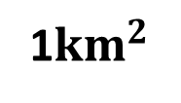
11+ MATHS ENTRANCE EXAM QUESTIONS
1000
53)
1km = _______m
54)
55)
Work out the missing angle in the triangle below:
(a) Show that 27 is not a perfect number.
1km = _______m
1${km}^{2}$
Kilo means 1000
Find the factors of 27 (excluding 27)
1000
1, 3 and 9
79°
1 + 3 + 9 =
13
Not perfect
43°
x
What is 1${km}^{2}$ in $m^{2}$
(b) Show that 28 is a perfect number.
1000m x 1000m
Find the factors of 28 (excluding 28)
Angles in a triangle add up to 180°
1km x 1km
=
1, 2, 4, 7 and 14
122
2
2
43 + 79 =
1km
=
1000000m
1 + 2 + 4 + 7 + 14 =
28
Perfect
58°
180 - 122 =
56)
Explain how you know that angles in a quadrilateral add up to 360°.
57)
What do angles in a pentagon add up to?
58)
What do angles in a octagon add up to?
180°
180°
180°
180°
180°
180°
180°
180°
180°
A quadrilateral splits into two triangles
180°
180°
180 + 180 =
360°
180° x 3 =
540°
180° x 6 =
1080°

Slide 5
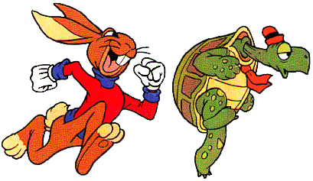
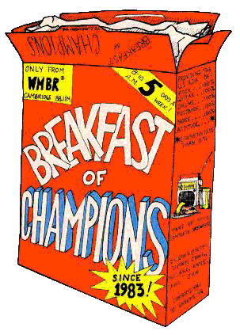

3 secs =
11+ MATHS ENTRANCE EXAM QUESTIONS
15m
3 secs = 5m
24)
HARE
TORTOISE
25)
A box of cereal contains 375g.
0m
50m
3 secs
3 secs
15m
55m
3 secs
3 secs
30m
60m
The tortoise and the hare agree to have a race. The hare lets the tortoise have a 50 metre start. The hare can run 5 metres in one second. It takes the tortoise
3 seconds to run 5 metres. How long does it take the hare to catch the tortoise?
3 secs
3 secs
45m
65m
3 secs
3 secs
60m
70m
3 secs
3 secs
75m
75m
15 seconds
The supermarket has 18 boxes on the shelf.
25)
26)
A new TV costs £60 deposit and then £40 per month for 1 year.
(a) How much will be paid after 5 months?
(a) What is the total amount of cereal in these boxes?
Total paid increases by £40 every month
6750g
3 7 5
x
0
0
0
1
8
4 months
5 months
3
7
5
£220
£260
£260
6
2
5
4
1
4
6
0
1
5
0
(b) After how many months will he have paid £340?
7
7 months
7 months
(b) Jane eats 40g of cereal each day for breakfast. For how many days will a box of cereal last her?
6 months
£300
£340
9 days
(c) Write a formula to connect the number of month (M) and the amount paid (P).
1 day
2 days
3 days
4 days
5 days
6 days
7 days
40
80
120
160
200
240
280
Months | 0 | 1 | 2 | 3
Total paid | £60 | £100 | £140 | £180
8 days
9 days
10 days
P = 60 + 40M
320
360
400

